Slide 1

A Machine Learning Model Selection considering Tradeoffs between Accuracy and Interpretability
ICITEE 2021. The 13th International Conference on Information Technology and Electrical Engineering
Zhumakhan Nazir Dinmukhamed Kaldykhanov
Kozy-Korpesh Tolep
Jurn-Gyu Park
Nazarbayev University Computer Science

Slide 2
Outline
Motivation and Examples
Related Works
Methodology
Results
Conclusion

Slide 3
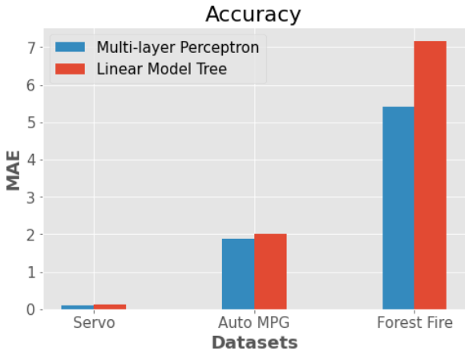
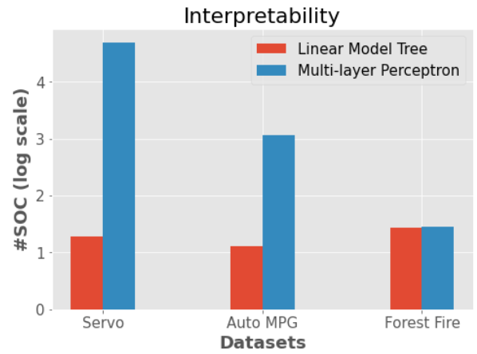
Motivation and Examples
Using ML in high stakes fields: medicine, criminology, cosmology and etc.
Accountable & Transparent
Black Box model
Simulatability – ability of user to simulate/run model
Examples
Simulatability Operation Count

Slide 4
Previous Works
Extract if-then based rules by:
Fit SVM and get reduced dataset represented by support vectors
Train simple model (tree model) by the reduced dataset
Conduct human evaluation of interpretability of models
Count the number of arithmetic operations performed (implementation dependent)
Count the number of arithmetic operations needed for each estimator
Simulatability Operation Count (SOC)
Example: Y = wX+b, where w = [w₁, w₂, w₃] and X = [x1, x2, x3]^{T}, then SOC = 3 + (3-1) + 1 = 2*3 = 6
In general, SOC(linear regression) = 2*len(w) = 2*len(X)

Slide 5
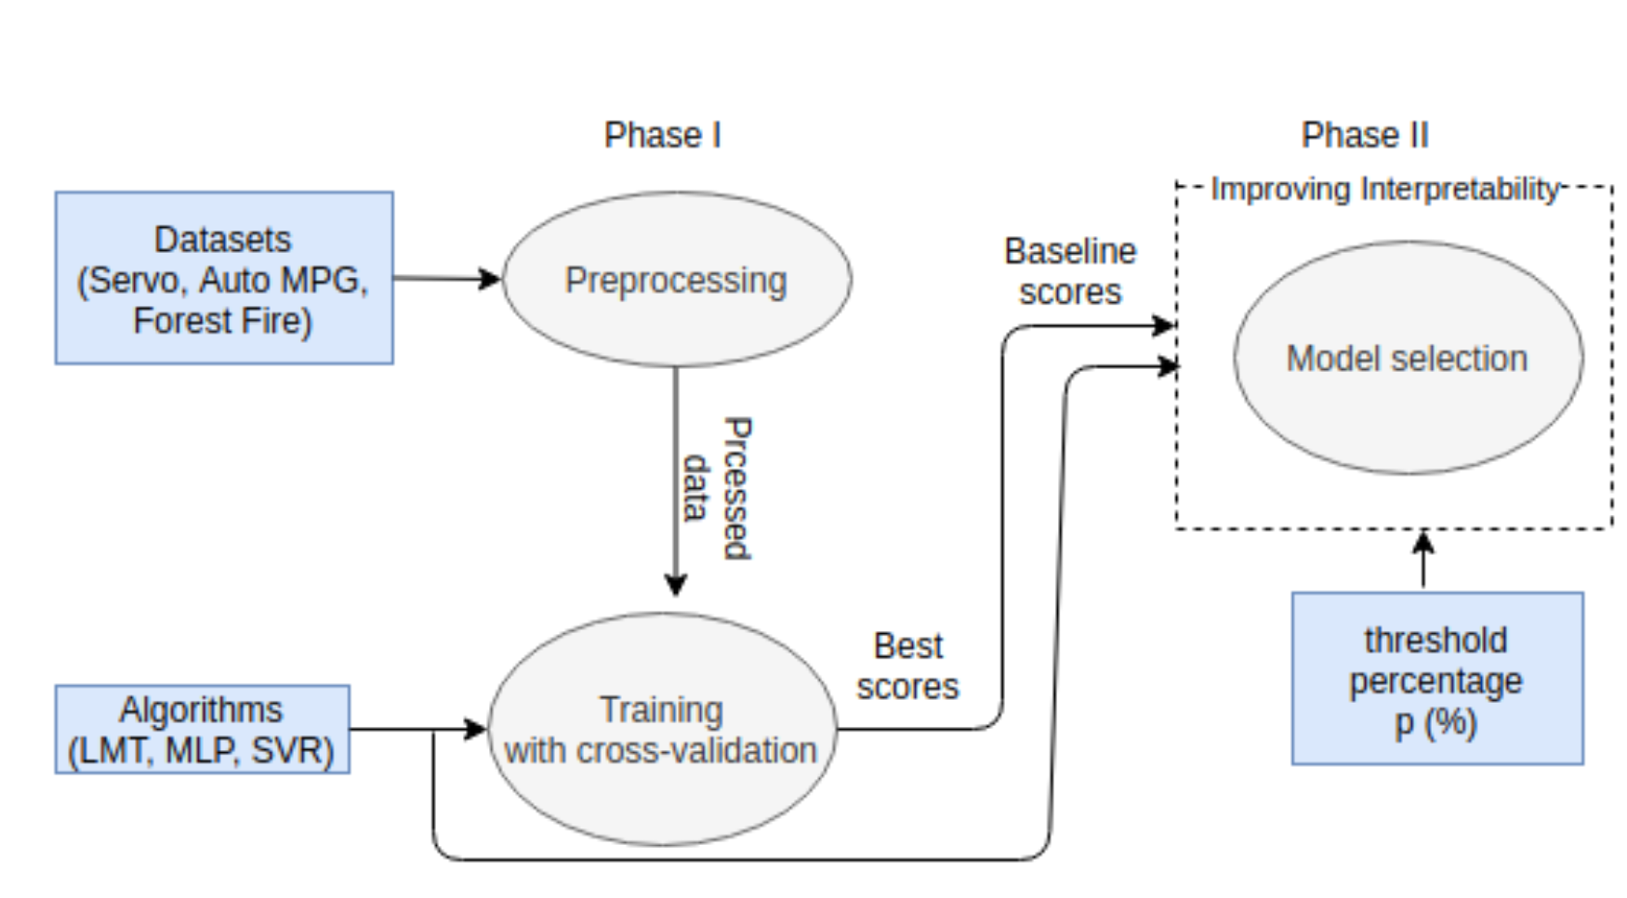
Methodology

Slide 6
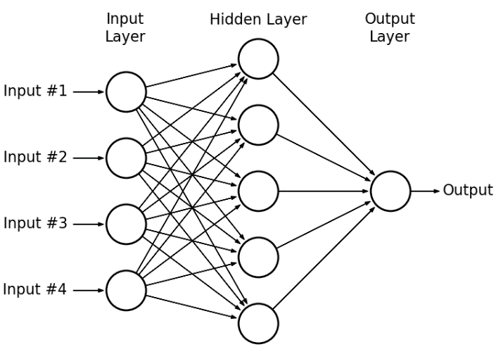
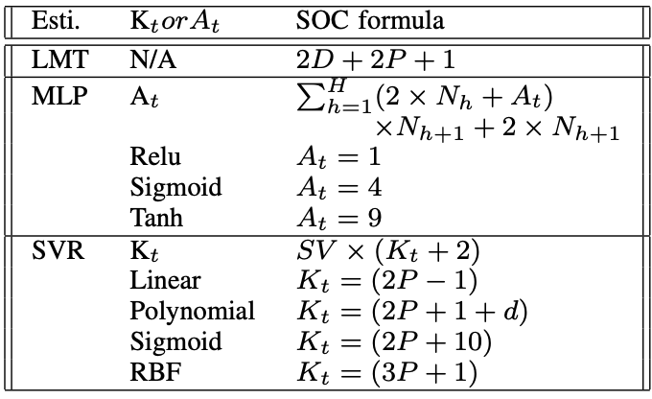
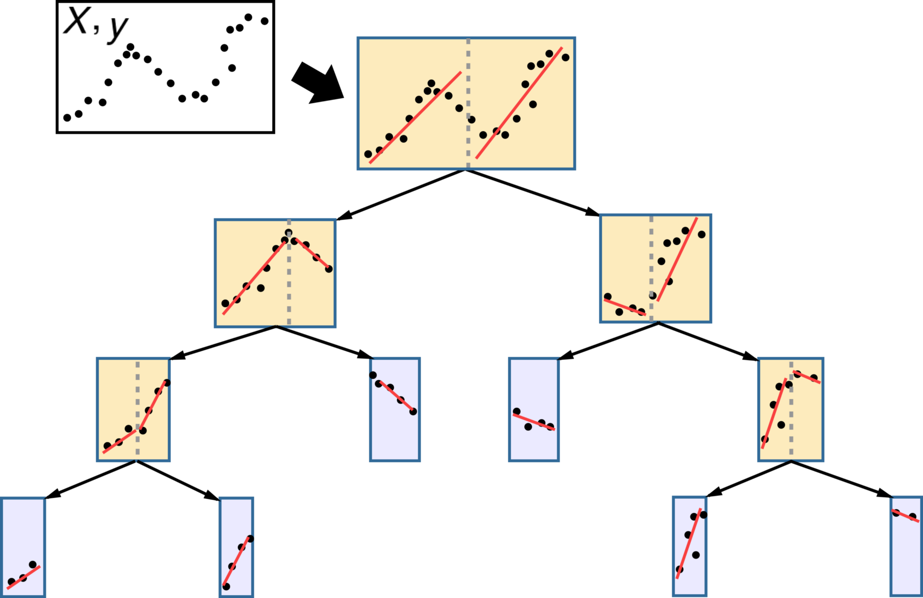
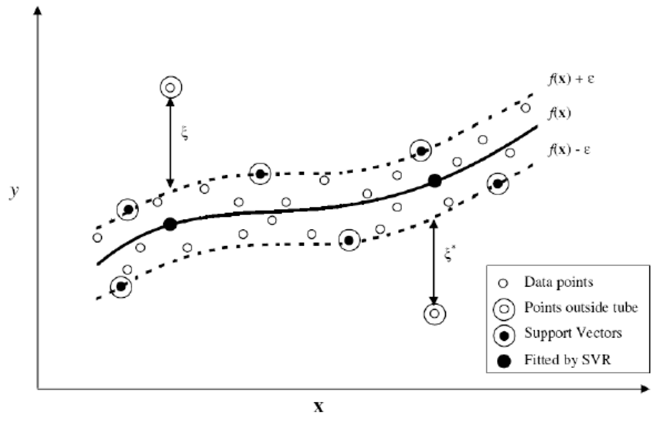
Methodology (Explain phase II)
[1] Linear Molde Tree
[2] Multi Layer Perceptron
SOC metric for estimators
[3] Support Vector Regression

Slide 7
Methodology (Explain phase II)
[1] Linear Molde Tree
[2] Multi Layer Perceptron
SOC metric for estimators
[3] Support Vector Regression

Slide 8
Methodology (Explain phase II)
[1] Linear Molde Tree
[2] Multi Layer Perceptron
SOC metric for estimators
[3] Support Vector Regression

Slide 9
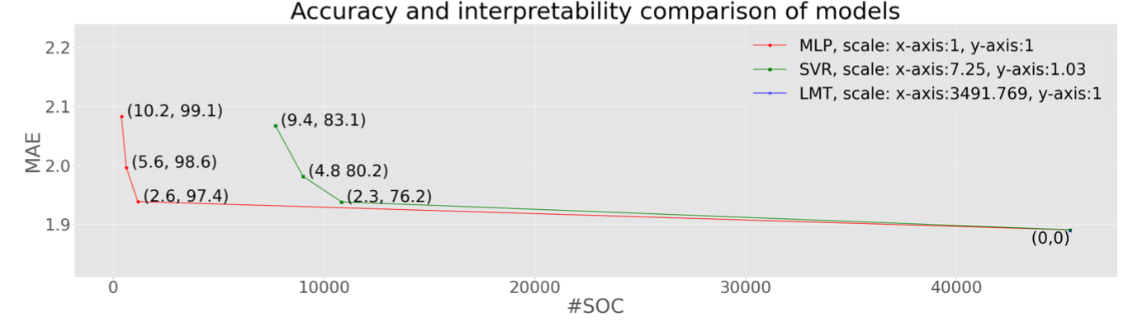
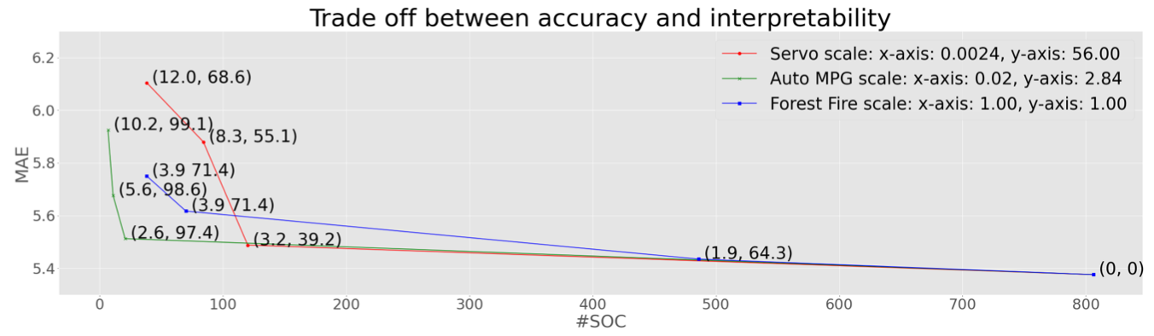
Results annotation (a,b) = % of (MAE increase, SOC decrease)

Slide 10
Conclusion
2.3% reduction of accuracy for 76.2% increase in interpretability (SVR on Auto MPG dataset)
10.2% reduction of accuracy for 99.1% increase in interpretability (MLP on Forest Fire dataset)
Impact
Trade-off methodology can be applied for many applications
Further research
More estimators
Classification tasks

Slide 11
References
[1] Introduction to Model Trees from scratch. Anson Wong, 2018. Towards Data Science. https://towardsdatascience.com/introduction-to-model-trees-6e396259379a
[2] Mohamed, H., Negm, A., Zahran, M., & Saavedra, O. C. (2015, March). Assessment of artificial neural network for bathymetry estimation using High Resolution Satellite imagery in Shallow Lakes: case study El Burullus Lake. In International water technology conference (pp. 12-14).
[3] Lahiri, S. K., & Ghanta, K. C. (2008). The support vector regression with the parameter tuning assisted by a differential evolution technique: Study of the critical velocity of a slurry flow in a pipeline. Chemical Industry and Chemical Engineering Quarterly, 14(3), 191-203.

Slide 12
Q&A

